Slide 1
Distance and Displacement

Slide 2
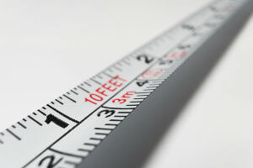
Welcome to this Smart Lesson on distance and displacement!
After completing this Smart Lesson you will be able to:
Explain the difference between distance and displacement.
Explain the difference between vectors and scalars.
Add horizontal and vertical vectors.
Resolve vectors into vertical and horizontal components.

Slide 3

Throughout this Smart Lesson we will be exploring the Polish city of Wroclaw (read: vrot-swaf).

Slide 4
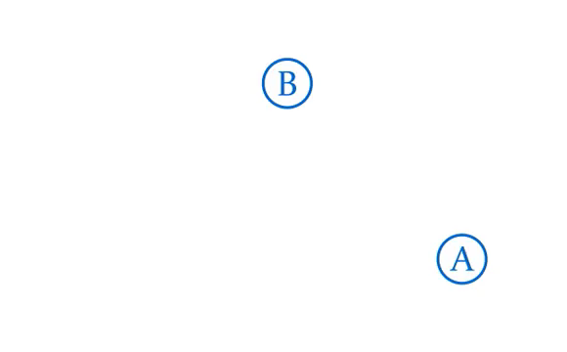
Imagine you want to get from point A to point B. Getting from A to B is impossible if you don't know the distance from A to B.
The distance from A to B is 300 m.

Slide 5
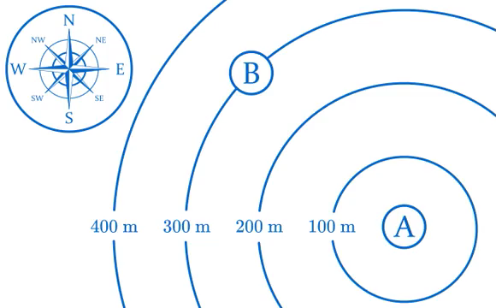
But distance isn't enough! You also need to know the direction from A to B. To describe the distance AND direction between two points we use a quantity called displacement.
Direction can be recorded using a compass rose. Imagine a line from A to B, and pick the line in the compass rose that points in the same direction.
The direction from A to B is northwest (NW).

Slide 6
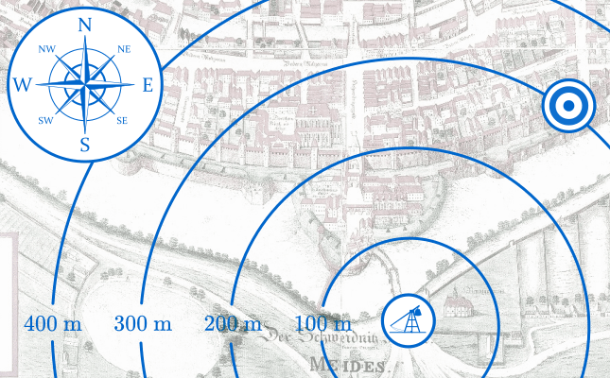
Example
Your trebuchet is all set up on the riverbank, ready to fire at the city wall. To fire a trebuchet accurately, the distance and direction to your target must be known.
What is the displacement of the target below?

Slide 7
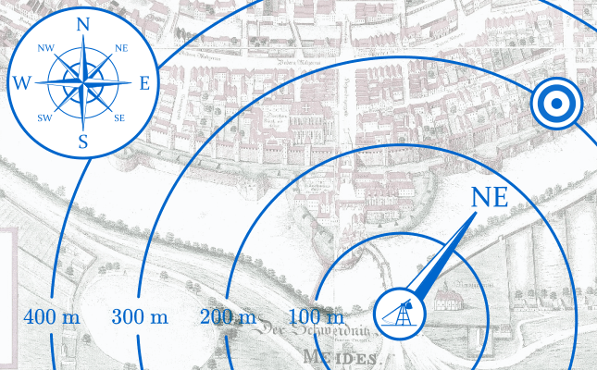
Solution
The line on the compass rose that points in the same direction as the target is the northeast line.
The target is 300 m northeast.

Slide 8

Distance is a scalar, which means it's described by a size only. Other examples of scalars are temperature and mass. None of these quantities have a direction.
Displacement is a vector, which means it's described by a size and direction. Another example of a vector is the force of gravity, as it has a size (9.8 ms⁻²) and direction (toward the centre of the Earth).
Both distance and displacement are measured in metres (m).

Slide 9
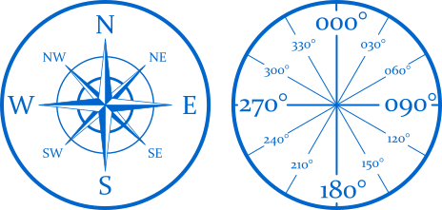
Compass points aren't very accurate. However, we can measure a direction as a bearing. Bearings are angles in degrees from 000° to 359°, and are measured clockwise from north.

Slide 10
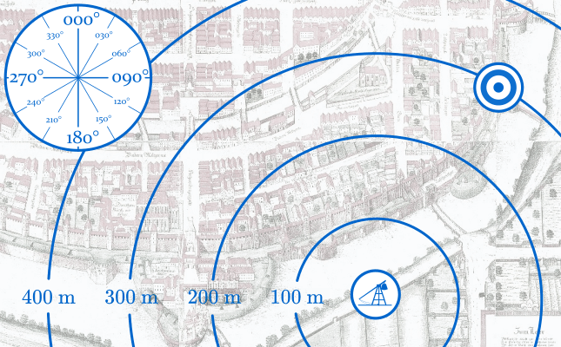
Example
What is the bearing from the trebuchet to the target below?

Slide 11
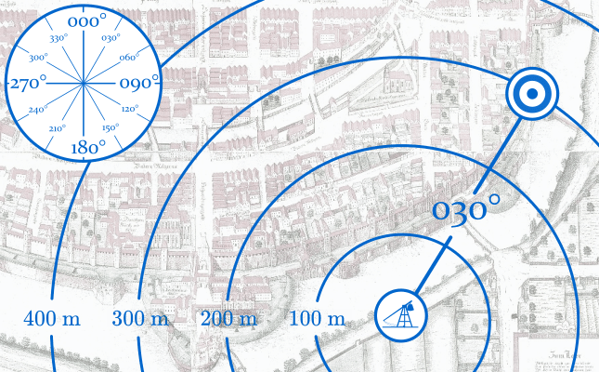
Solution
Looking at the protractor, we can see that the angle from north is approximately 030°.
Therefore, the bearing of the target below is 030°.

Slide 12
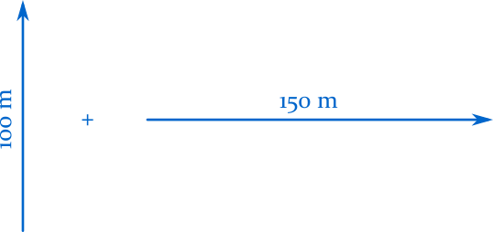
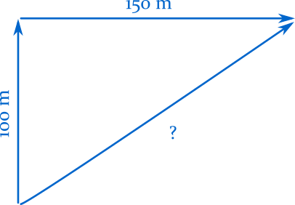
In this section we'll learn how to add vectors together.
Adding two vectors together yields another vector, with a size and direction of its own.
Vectors are added by connecting the arrowhead of one vector to the tail of a second vector. The sum of the two vectors is the distance and direction from the tail of the first, to the tip of the second:

Slide 13
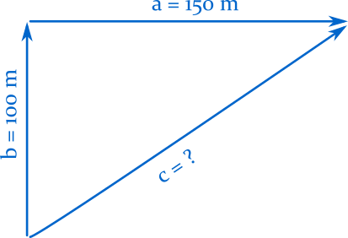
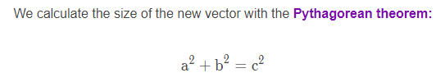

Slide 14
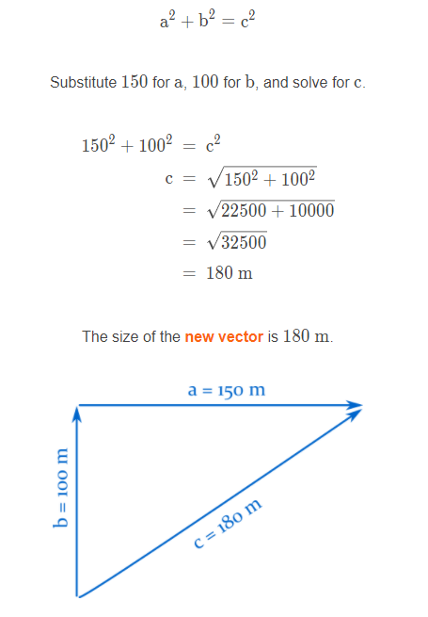

Slide 15
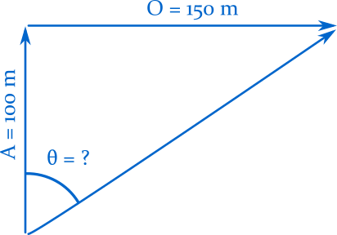

To work out the direction of the new vector we use trigonometry to calculate the angle (θ) inside the triangle:
In this case we'll use the tangent function, as we know the opposite (O) and adjacent (A) sides, and want to find the angle:

Slide 16
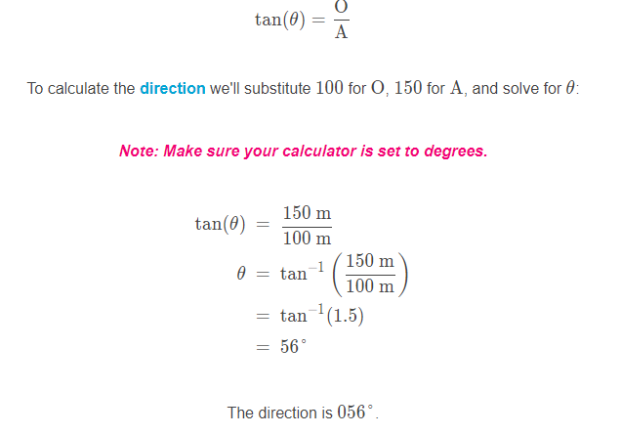
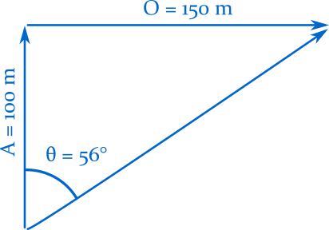

Slide 17
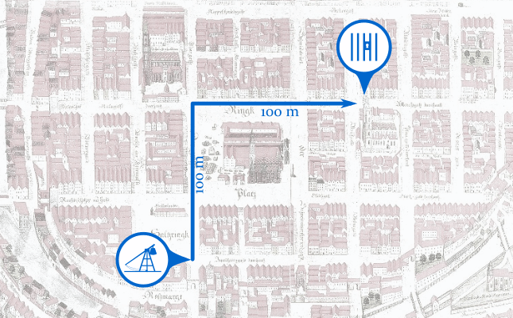
Example
One of your trebuchets has destroyed the south gate, and advanced into the city. A local has provided you with directions to a jail, where several of your soldiers are imprisoned:
"To get to the jail, walk 100 m north, then 100 m east."
Instead of walking over to explain the situation, let’s fire the trebuchet at the jail to break them out.
What is the distance from the trebuchet to the jail?

Slide 18
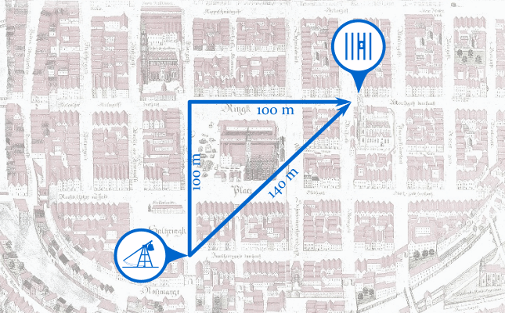
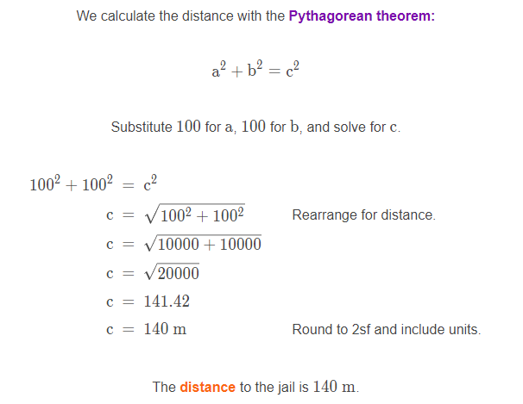
Solution

Slide 19
Example
The distance from the trebuchet to the jail is 140 m.
What is the direction from the trebuchet to the jail?

Slide 20
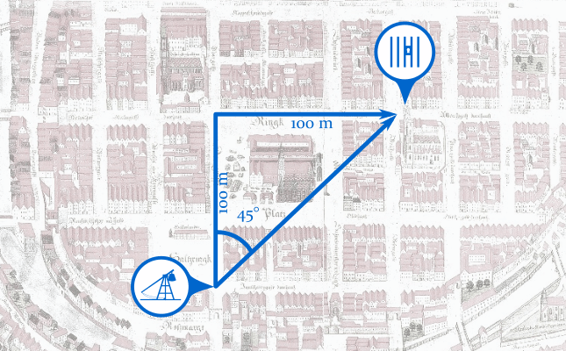
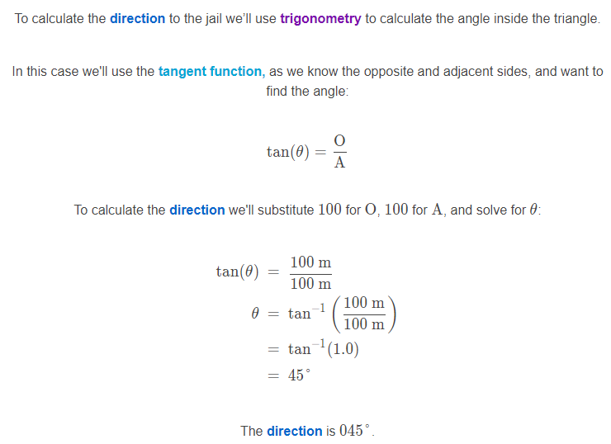

Slide 21
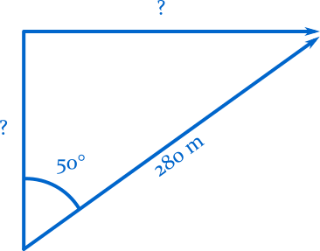
In this section we'll learn how to resolve vectors into horizontal and vertical components.
Resolving means taking a vector with a complicated direction like 017° or 239°, and splitting it into two vectors with simple directions, like north or east.

Slide 22
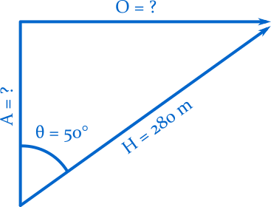
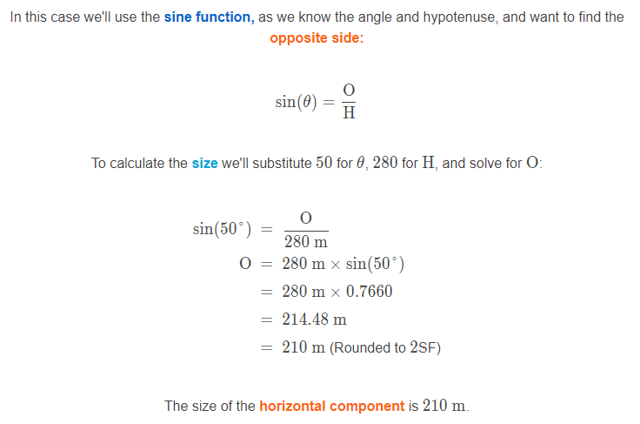
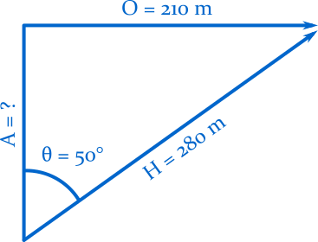
To work out the size of the horizontal vector we use trigonometry.

Slide 23
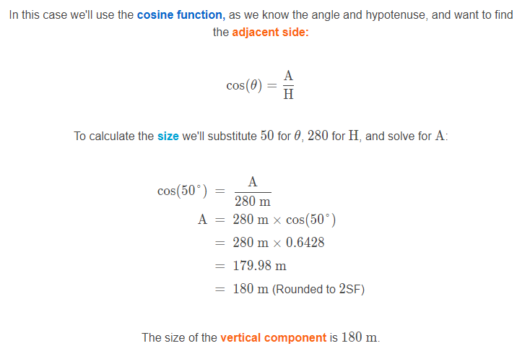
We use trigonometry to work out the size of the vertical vector as well.

Slide 24
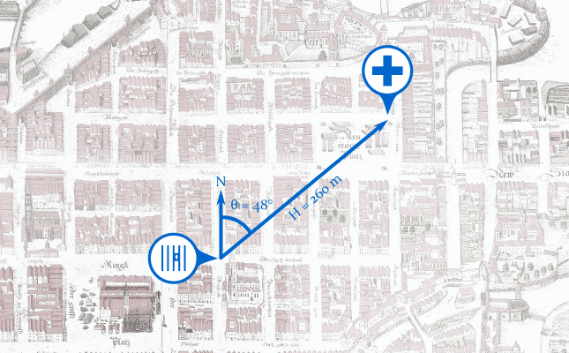
One of your soldiers was injured when the jail was destroyed. Fortunately there is a doctor in the city, 260 m away at a bearing of 048°.
How far does the doctor have to walk to the jail?

Slide 25
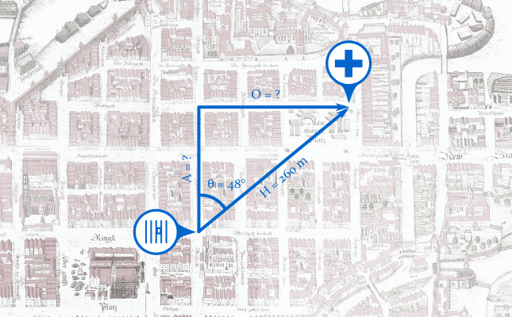
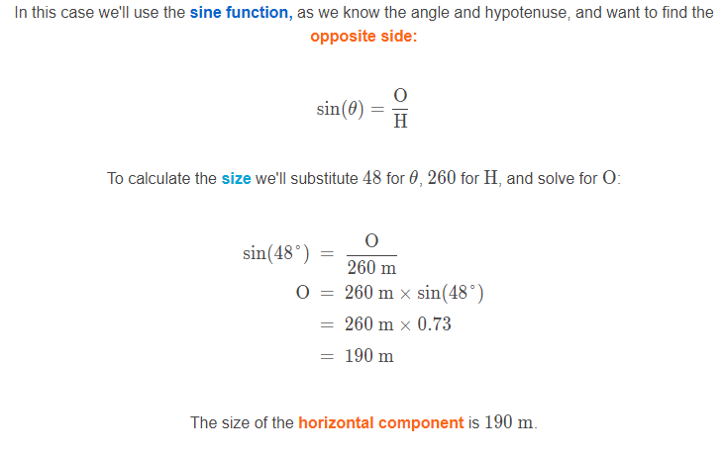
Use trigonometry to work out the size of the horizontal vector.

Slide 26

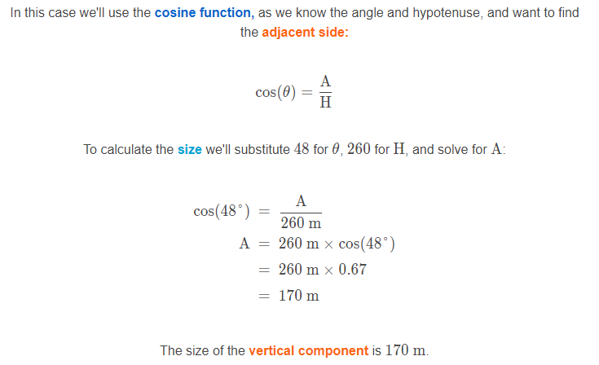

Slide 27

